Slide 1


The Prediction of Survival of Patients in the ICU (Intensive Care Unit)
Group 10 – Hymavathi Gummudala, Lakshmi Mounica Kalahasti, Sami King, Shashikant Reddy LNU, Mansi Pagare, Kanishkaa Sharma, Rohith Sureddi

Slide 2

INTRODUCTION :
Several research studies have been completed over the years to evaluate the attributes which are significant in determining the survival of a patient after being admitted to a hospital.
A study revealed that the chronic conditions of patients can predict the chances of readmission and mortality (Journal of Applied Gerontology, Conner).
ICU’s typically have insufficient medical data of incoming patients and the patients getting admitted to the ICU’s are majorly unable to provide them with information on their chronic conditions.
A study proved that machine learning algorithm with random forest can report mortality and length of stay of patients in ICU (Scientific reports, Shinya Iwase).
This dataset includes the highest and lowest values of different tests and conditions within the first 24 hours of patient’s admission. It comprises of ICU patient's blood tests and evaluations like sodium – potassium concentration in serum, blood pressure values, glucose estimate, heart rate count, etc done to monitor their health status.

Slide 3
AIM : The aim of this study is to identify and predict the survival of patient using demographic data, medical history and EHR (Electronic Health Record) records.
PURPOSE :
The purpose of our study is to determine the importance of the attributes that might indicate survival for patients with chronic illness using machine learning algorithms such as random forest classifier, XG Boost classifier etc.
According to study reported in Scientific reports, machine learning when implemented along with random forest (RF) are sufficient at reporting the mortality of patients in hospital Scientific reports, Shinya Iwase. Therefore, through this project we would like to identify what are the major attributes contributing to the survival. As the attributes will be taken from patient's data, medical history and considering current conditions, the results are considered error proof.

Slide 4
RESEARCH HYPOTHESIS:
Null Hypothesis (H₀): Hospital death does not have any relation to the patient's health attributes like age, BMI and other parameters taken into consideration for evaluation .
Alternate Hypothesis (H_{a}): Hospital death does have some relation to the patient's health attributes like age, BMI and other parameters taken into consideration for evaluation .

Slide 5
METHODOLOGY:
DATA COLLECTION:
DATA DESCRIPTION:
Patient Survival Prediction Dataset; This dataset was found on Kaggle, a community-based repository of datasets.
(https://www.kaggle.com/datasets/sadiaanzum/patient-survival-prediction-dataset?select=Dataset.csv).
Source of the dataset: https://journals.lww.com/ccmjournal/Citation/2019/01001/33__THE_GLOBAL_OPEN_SOURCE_SEVERITY_OF_ILLNESS.36.aspx
Data collection from two large intensive care databases from three countries, Australia and New Zealand (Australian and New Zealand Intensive Care Society Adult Patient Database [ANZICS-APD]) and the United States (eICU Collaborative Research Database [eICU-CRD)
Chronic Health Evaluation from Collaborative Research Database, using GOSSIS-1 = Global Open Source Severity of Illness Score-1 and Acute Physiology and Chronic Health Evaluation (APACHE) was carried out.
GOSSIS-1 is a modern, free, open-source in hospital mortality prediction algorithm for critical care patients, achieving excellent discrimination and calibration across three countries.
This dataset has a total of 186 columns and 91,713 rows. The rows indicate a patient, then the columns represent the patient’s characteristics and health attributes.
Dataset consist of information on patient demographic data and medical history including vitals, comorbidities and chronic conditions.

Slide 6
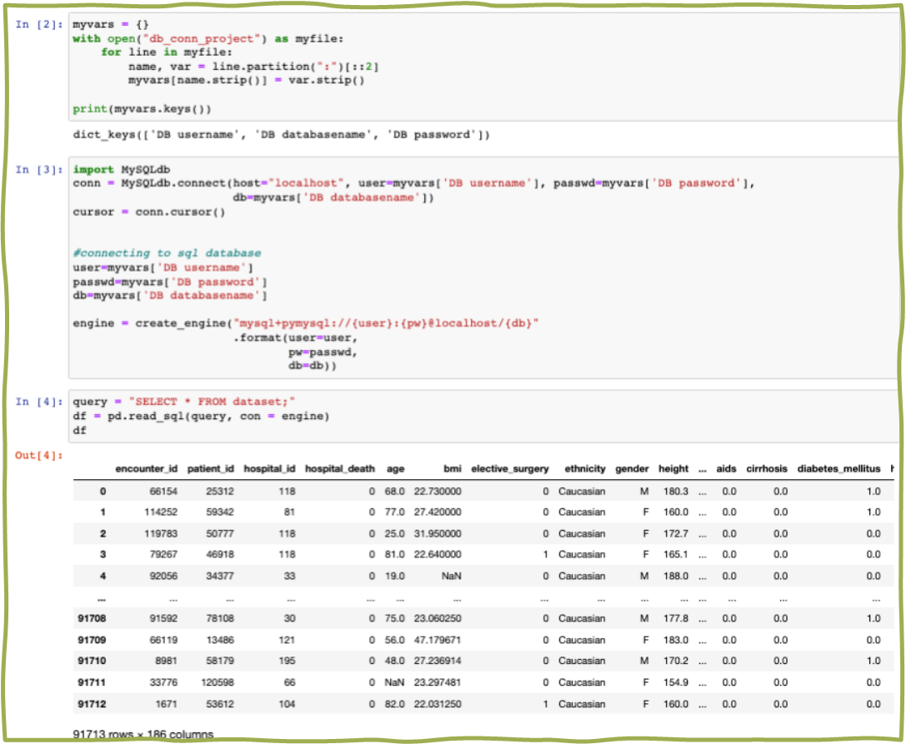
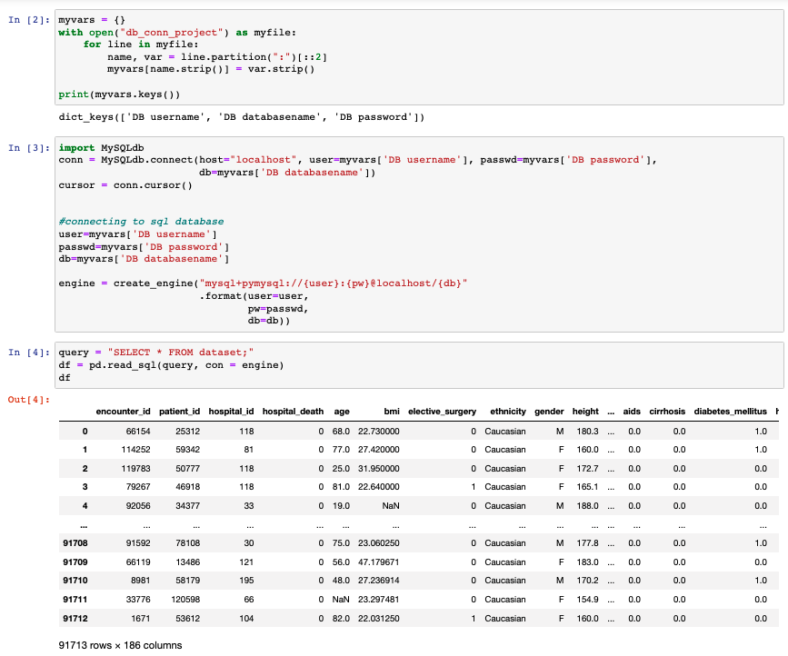
VIEWING DATASET:
Uploaded dataset to PHPMyAdmin
Reading dataset from PhpMyAdmin in Jupyter

Slide 7
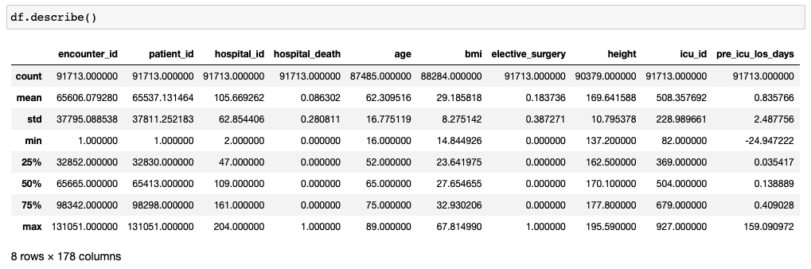
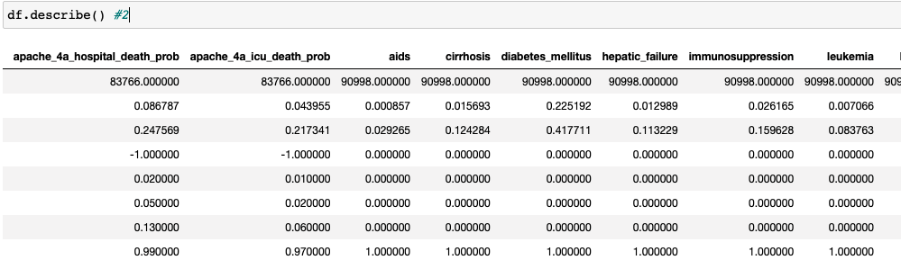
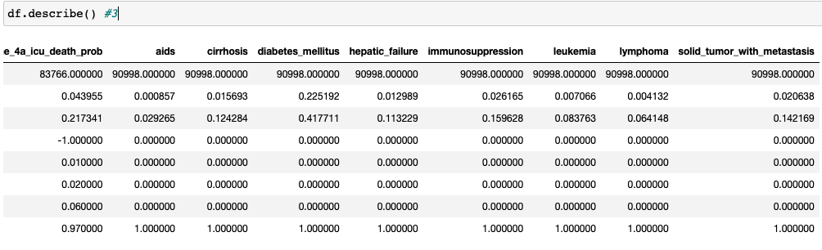
DESCRIPTIVE STATISTICS BEFORE DATA CLEANING:
Originally had 91,713 rows x 186 columns
178 of the 186 columns were numeric and could be described
Therefore, 8 columns were categorical
This required feature mapping later in the cleaning process

Slide 8
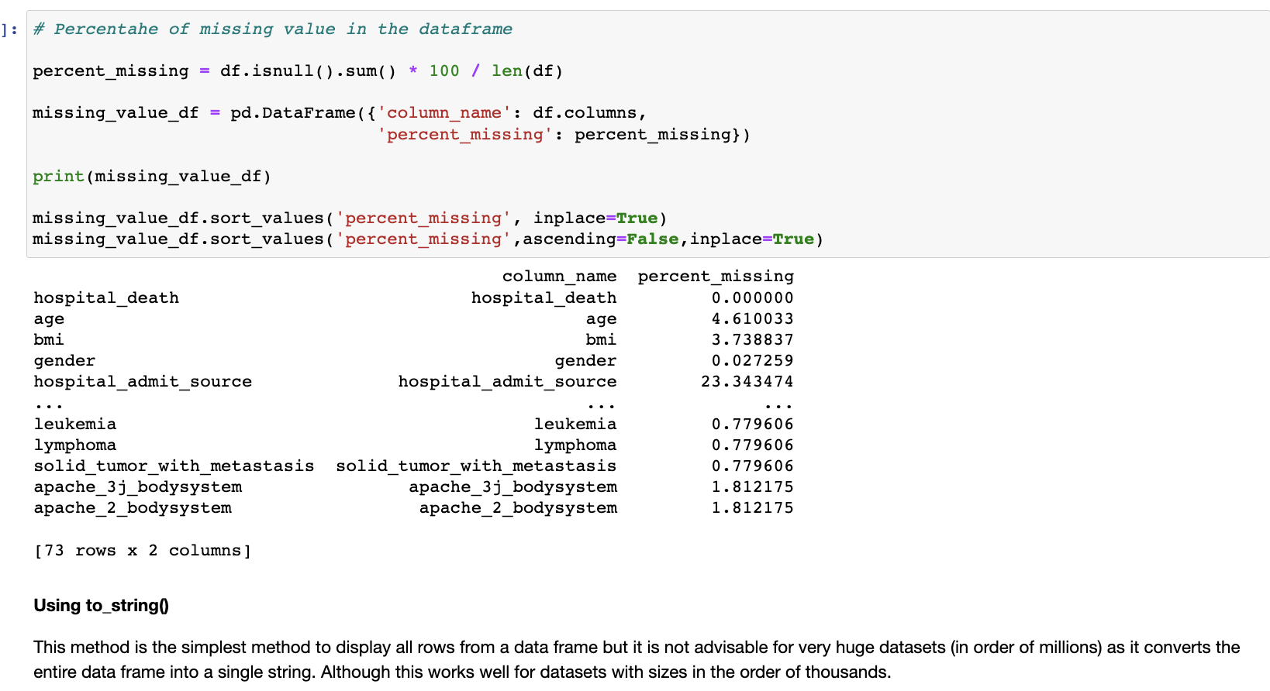
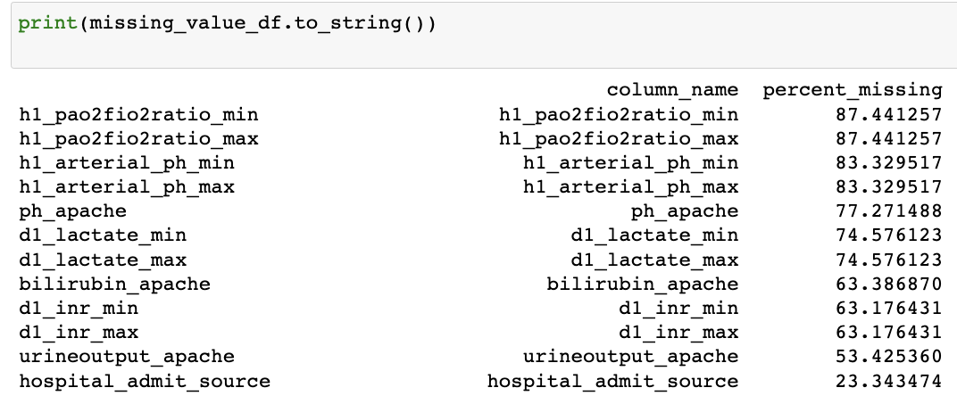
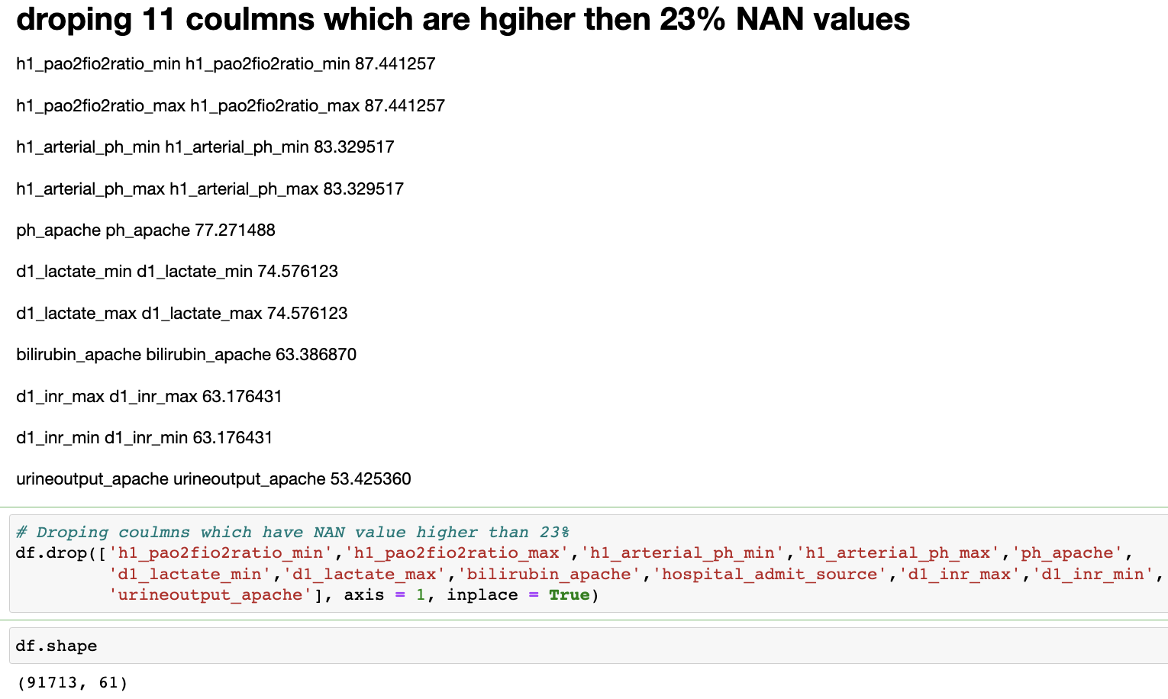
DATA CLEANING PART 1:
Started with 186 – deleted 113 based on domain knowledge
Of the remaining 73 features, if the column had > 20% nan values we dropped the column
61 columns were left

Slide 9
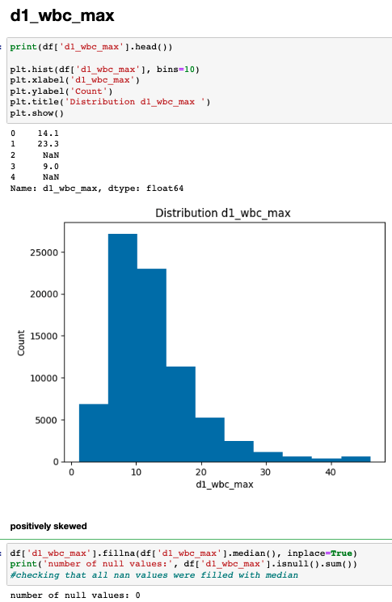
IMPUTATION:
Of the 61 features remaining, we had to impute for NAN
We first used histograms to determine if the values were negatively, normally, or positively skewed
If negatively or positively skewed, we replaced with median
If normally distributed, we replaced with mean
If the column was categorical, we replaced with mode

Slide 10
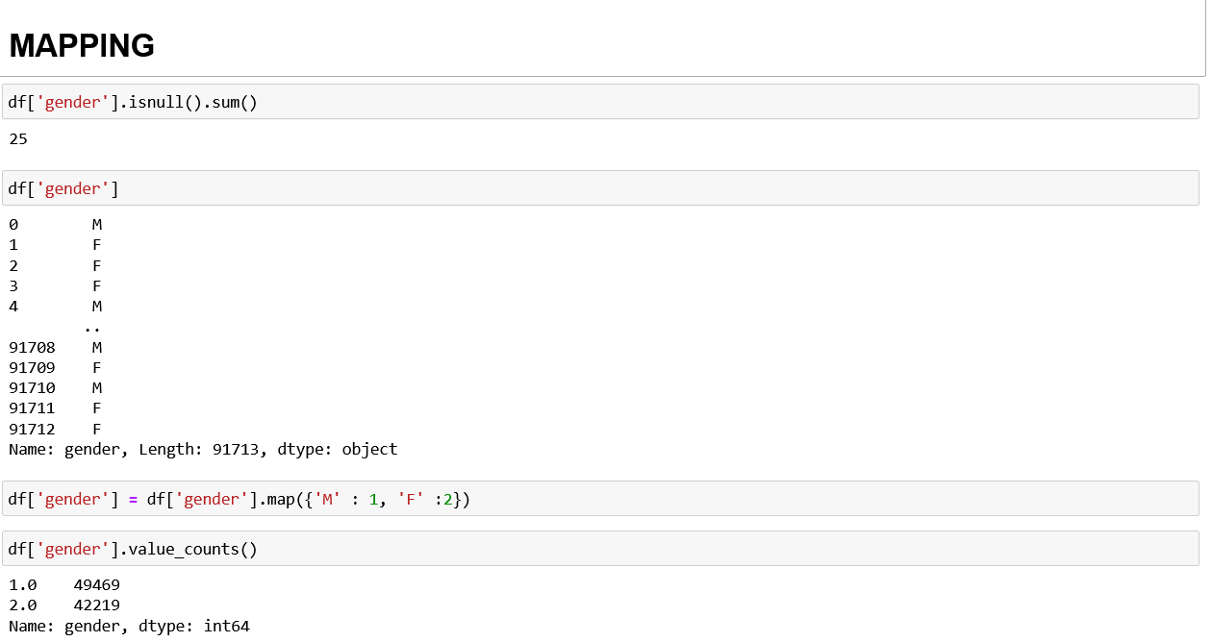
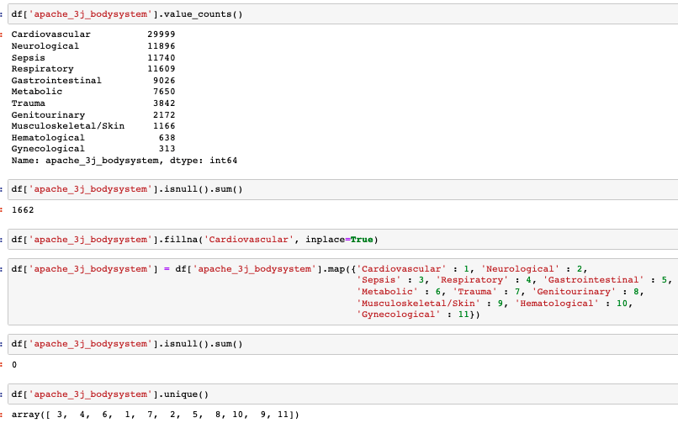
MAPPING & IMPUTATION:
Utilized mapping for categorical columns

Slide 11
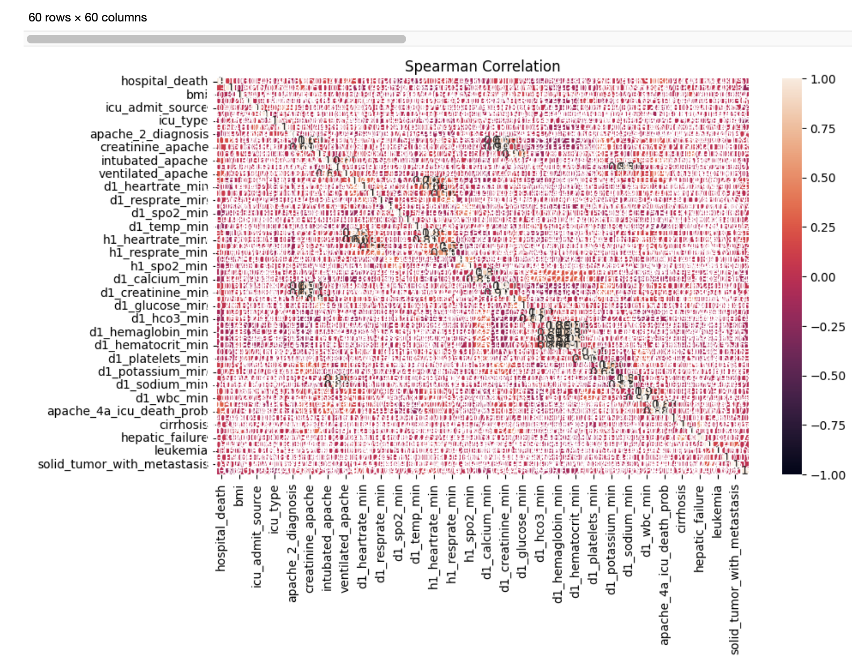
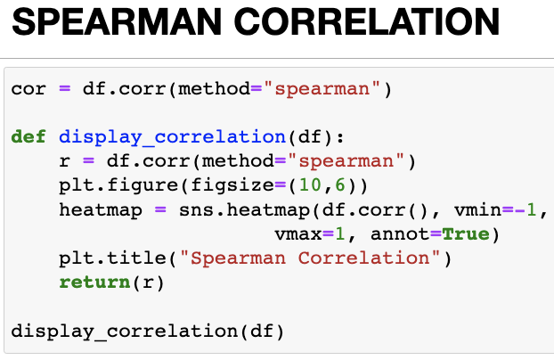
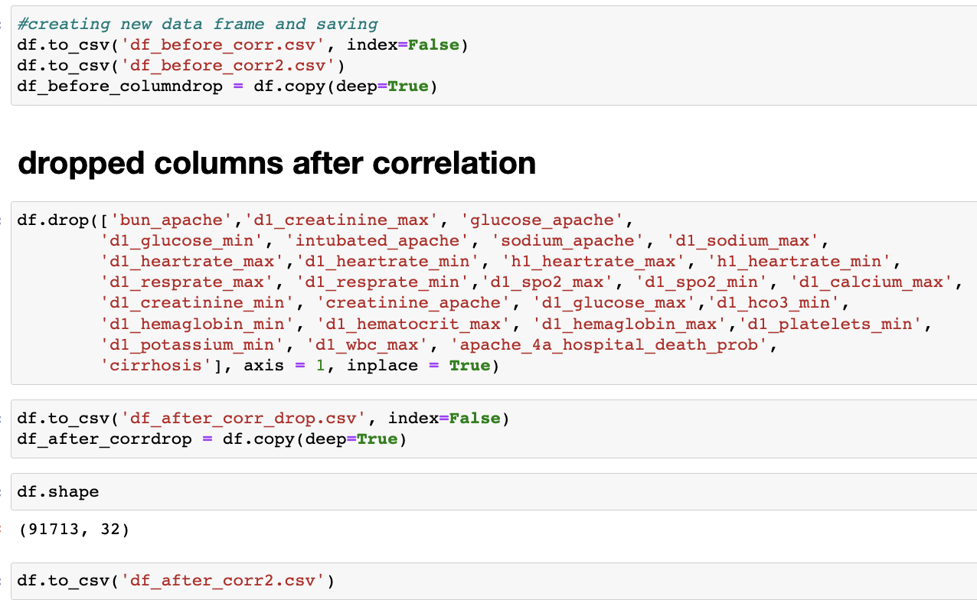
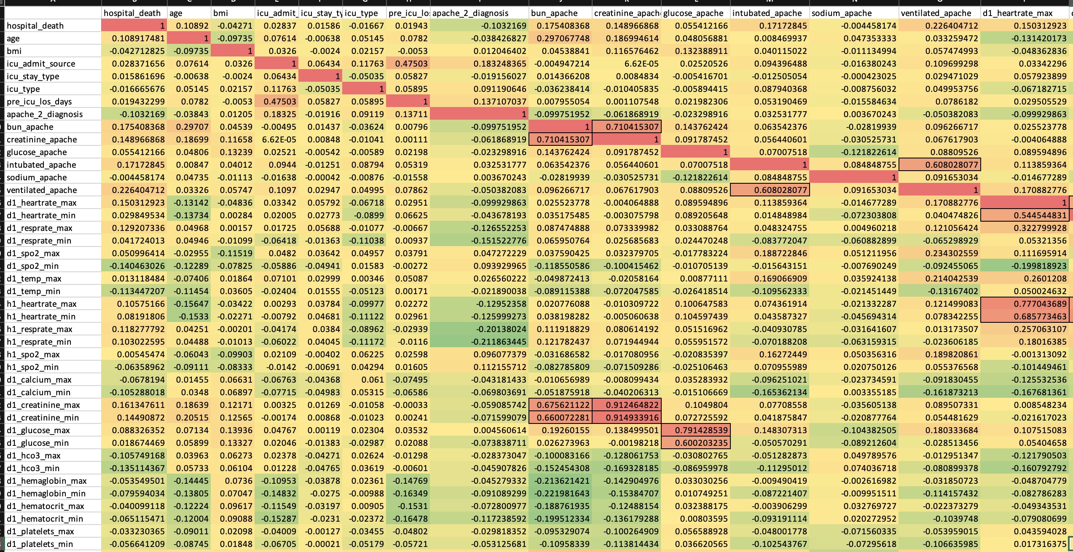
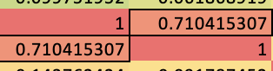
CORRELATION MATRIX #1:
Performed Spearman Correlation on remaining 61 features
0.5-1 and –0.5-(-1) correlation threshold was taken to remove correlated columns. 32 columns were left.
Not all columns are featured in screenshot

Slide 12
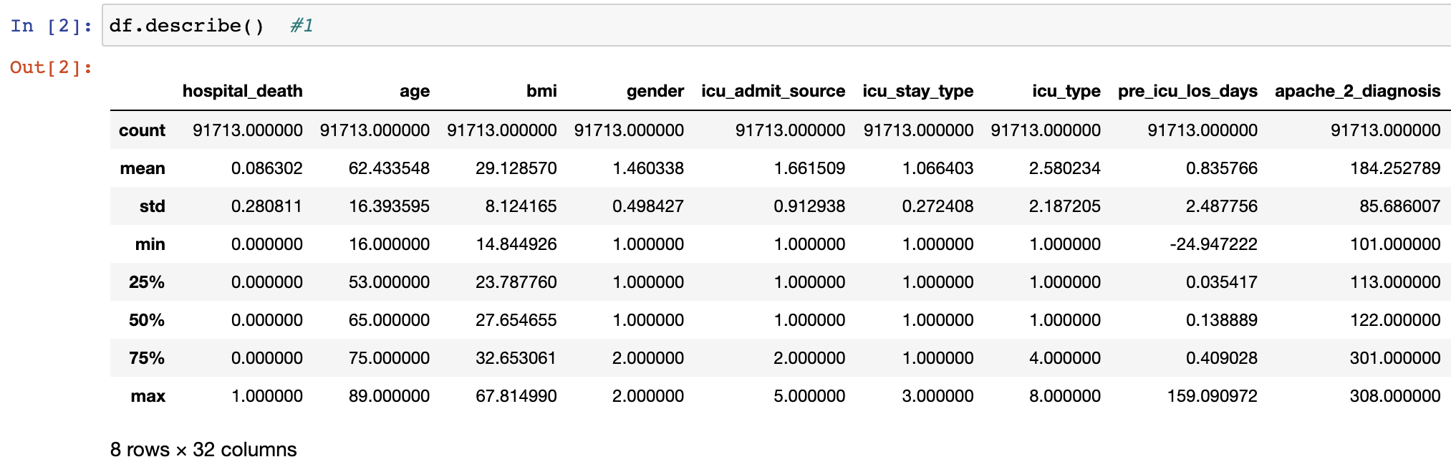
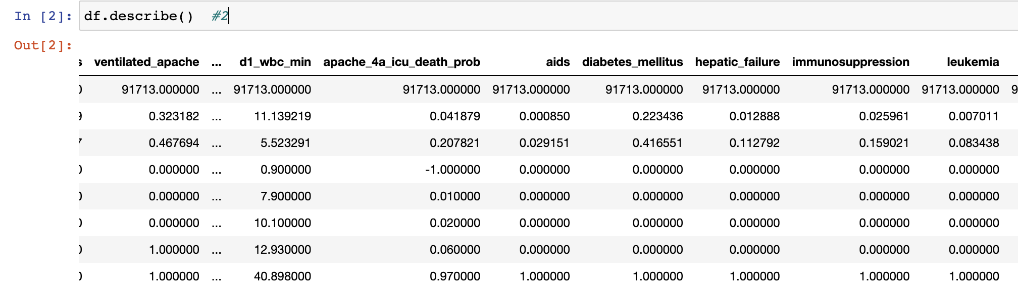
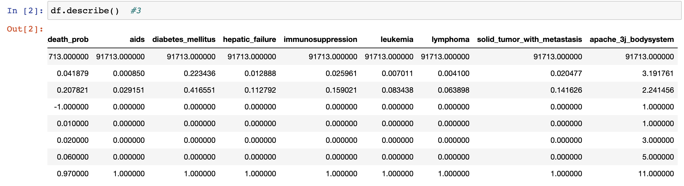
DESCRIPTIVE STATISTICS:
Spearman Correlation was performed , After removal of correlated columns. 32 columns were left .

Slide 13
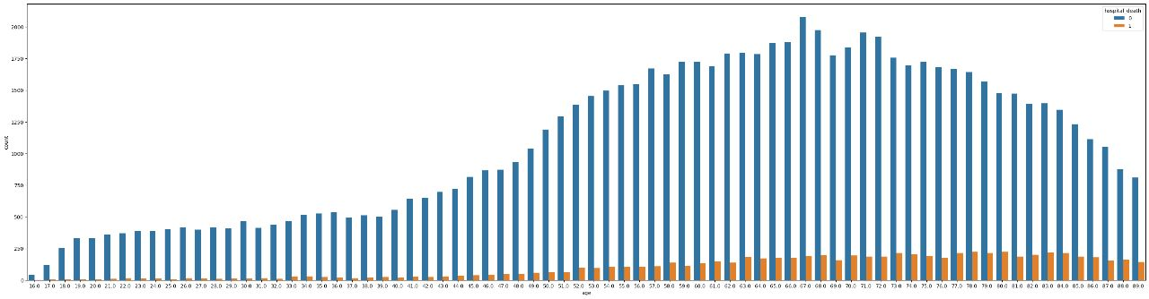
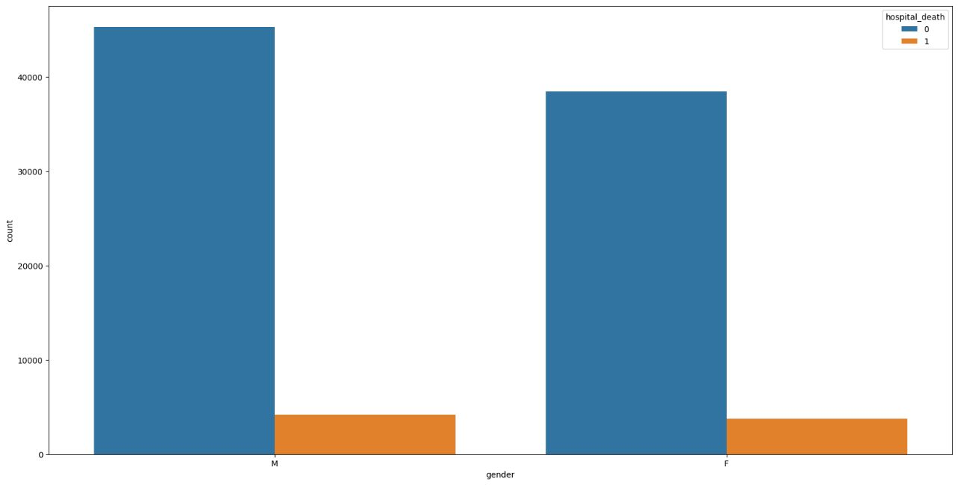
VISUALIZATIONS:
Age
Gender
Patient’s below 30 Years of age have lowest and over 70 Years of age have highest mortality rate.
Male patients have slightly higher mortality rate than female patients.

Slide 14
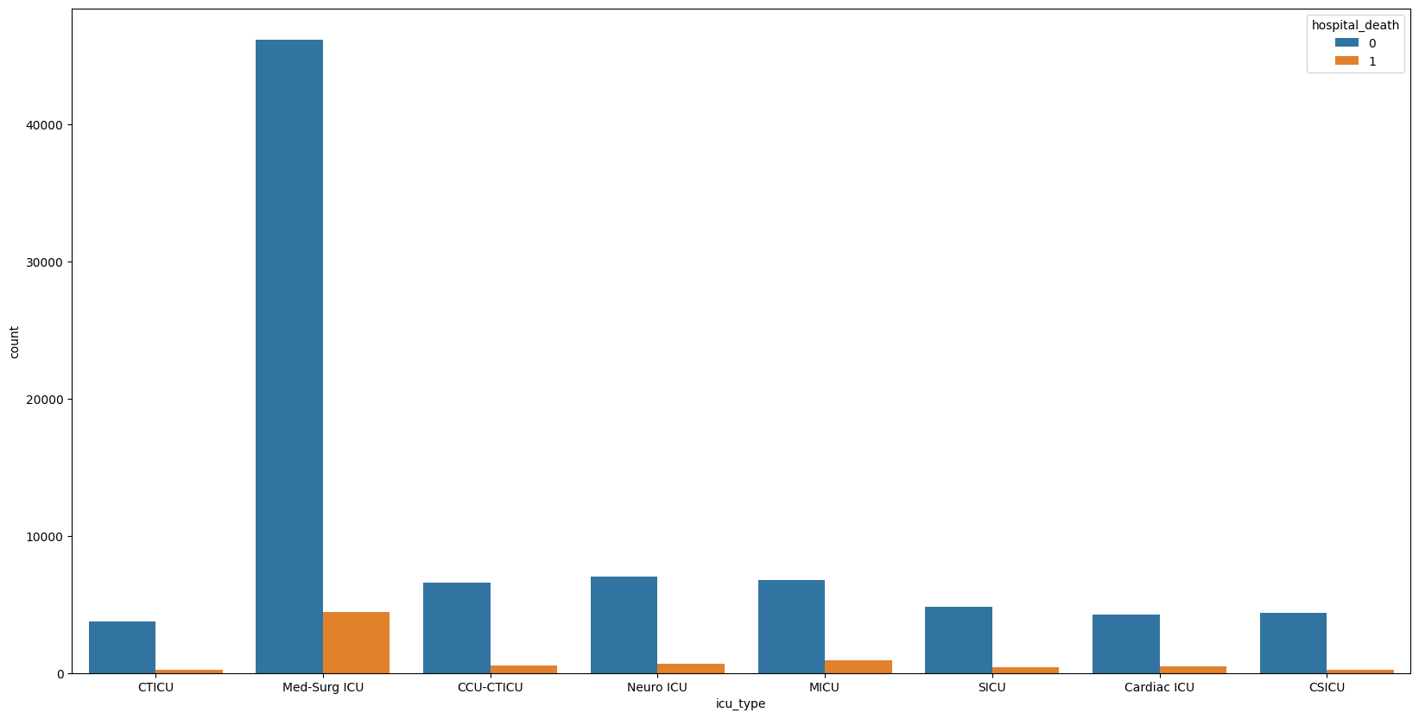
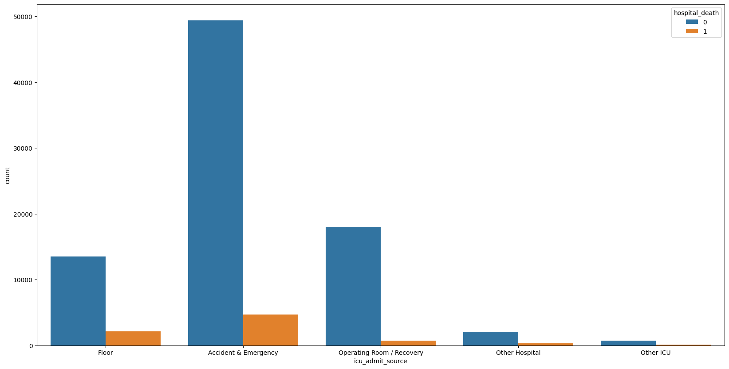
VISUALIZATIONS:
ICU Type
Admission Reason
Cardiothoracic Intensive Care Unit (CTICU) and Cardiac Surgery Intensive Care Unit (CSICU) have lowest number of patient’s death.
Medical-Surgical ICU have highest number of deaths.
Patients referred to other ICU units have lowest fatality rate while patients referred to accident & emergency wards have highest fatality rate.

Slide 15
Randomized Search CV optimization
XGBoost classifier
Random Forest classifier
METHODOLOGY:
MODEL DEVELOPMENT

Slide 16


PERFORMANCE ANALYSIS:
Synthetic Minority Oversampling Technique (SMOTE)
ROC Curve

Slide 17
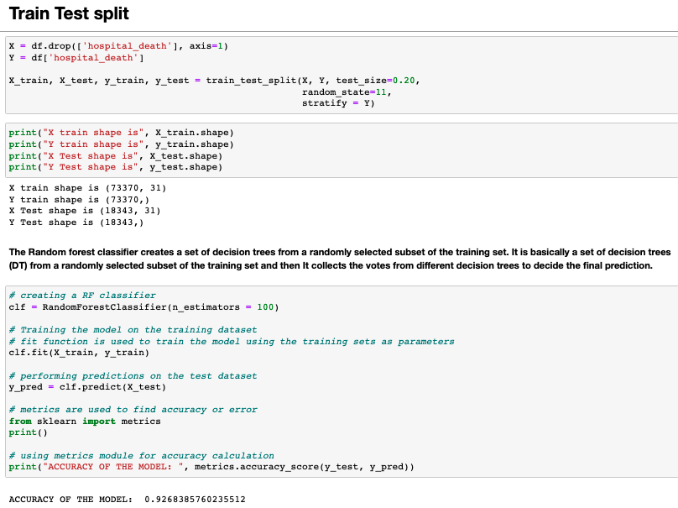
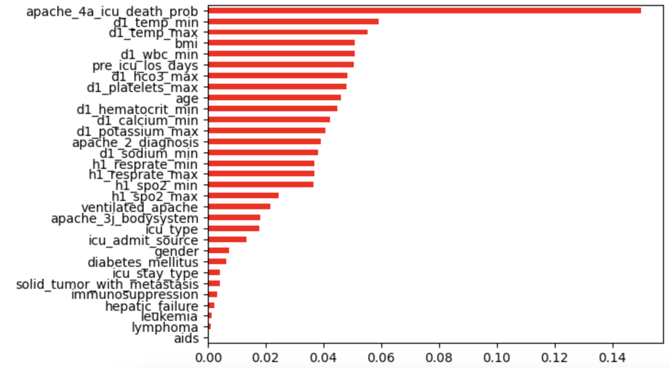
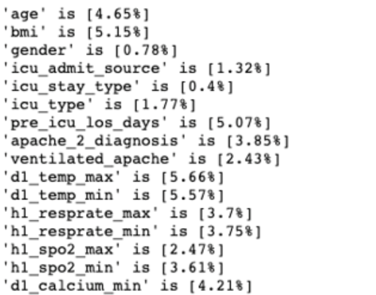
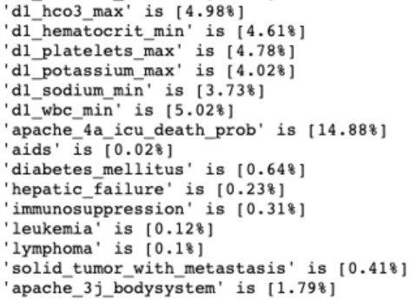
RANDOM FOREST (RF) MODEL:
FEATURE IMPORTANCE

Slide 18
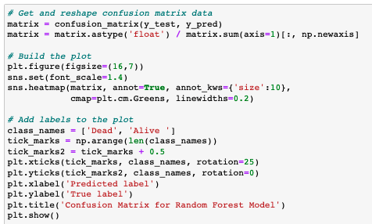
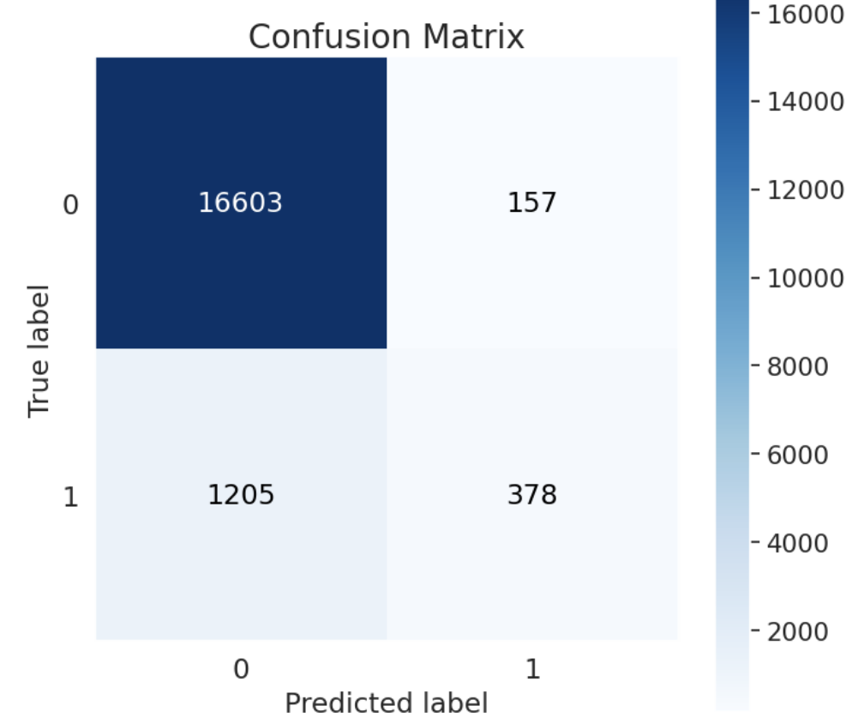
RANDOM FOREST MODEL CONT.:

Slide 19
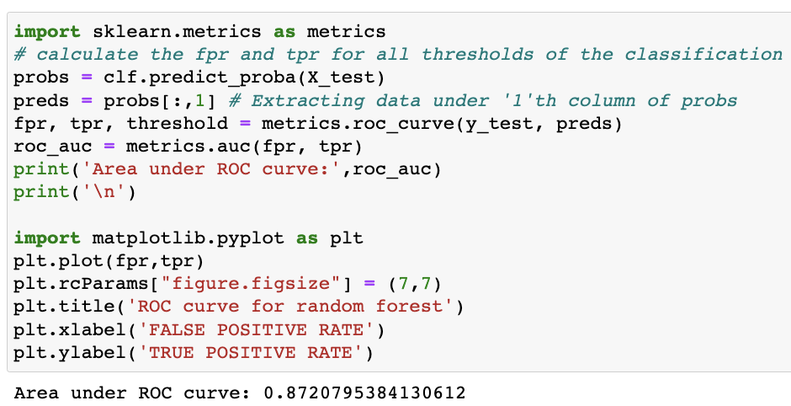
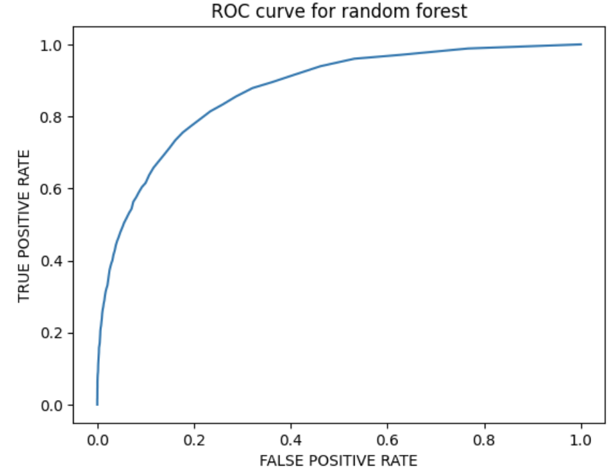
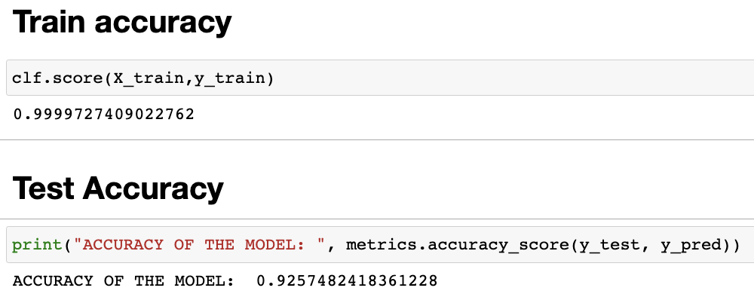
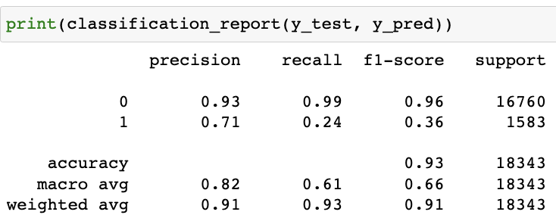
ROC CURVE FOR RF before SMOTE:

Slide 20
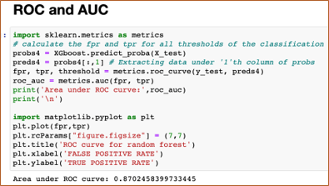
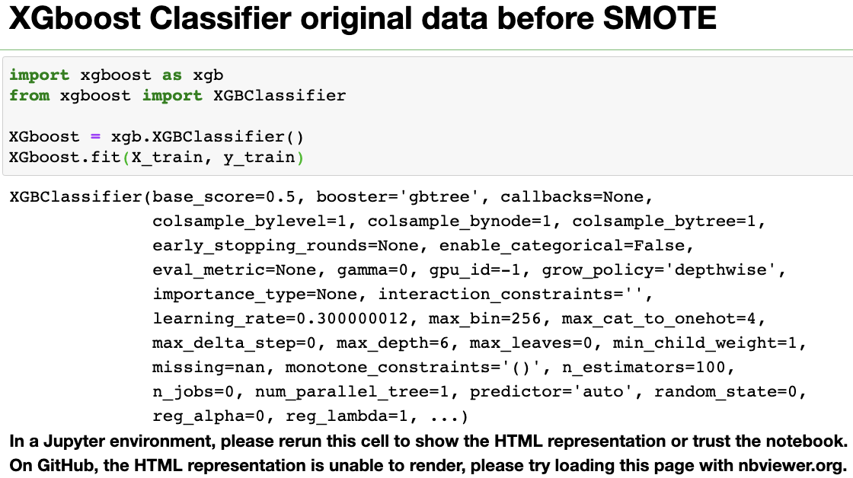
XGBOOST CLASSIFIER CODE before SMOTE:

Slide 21
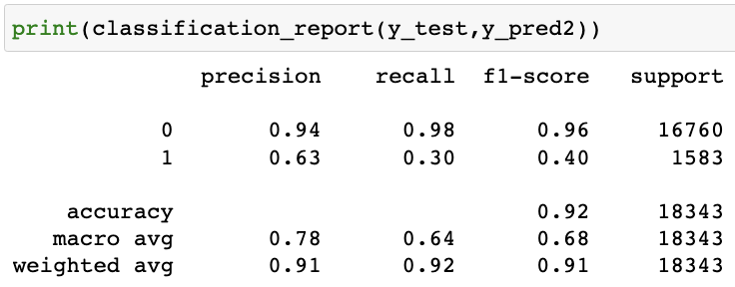
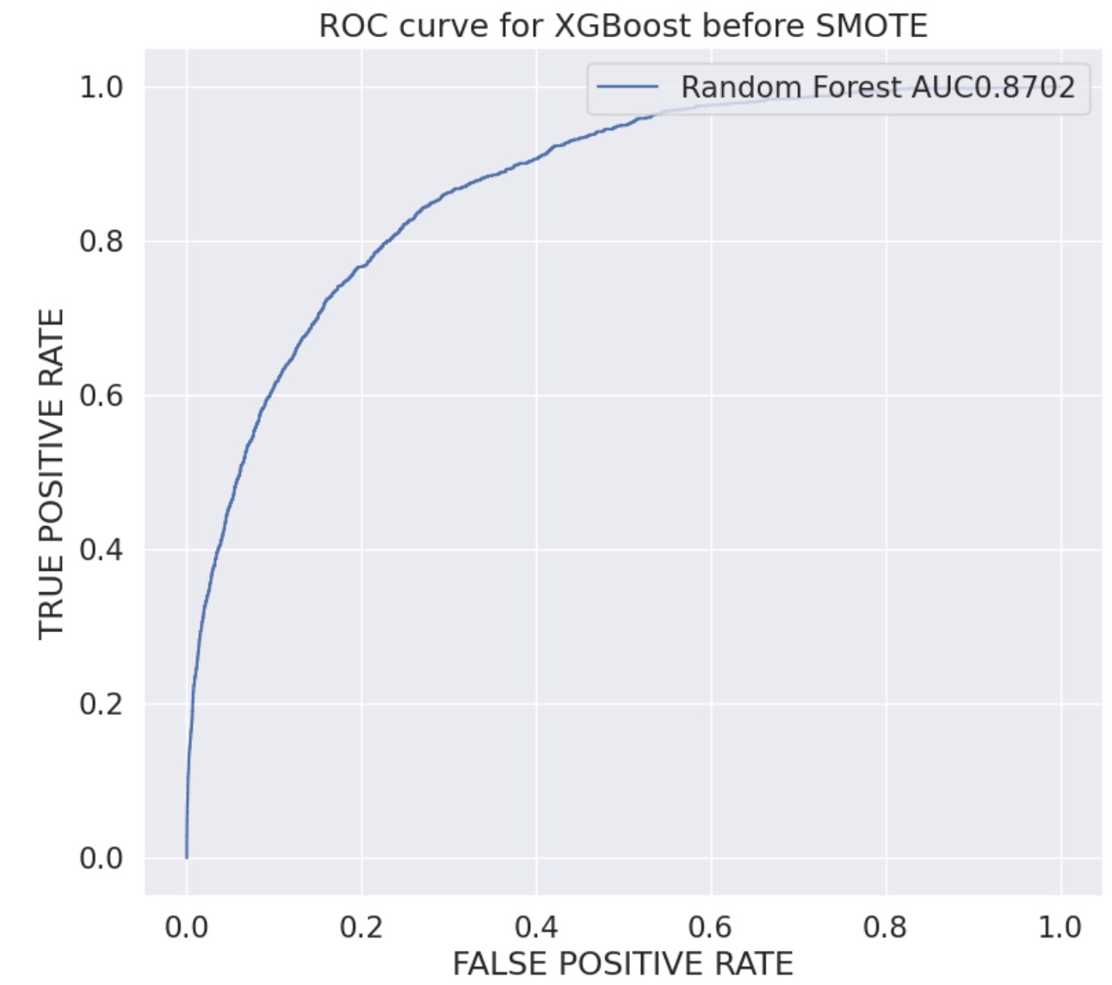
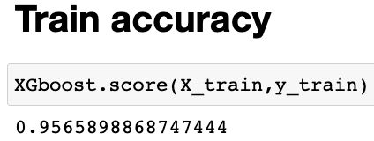
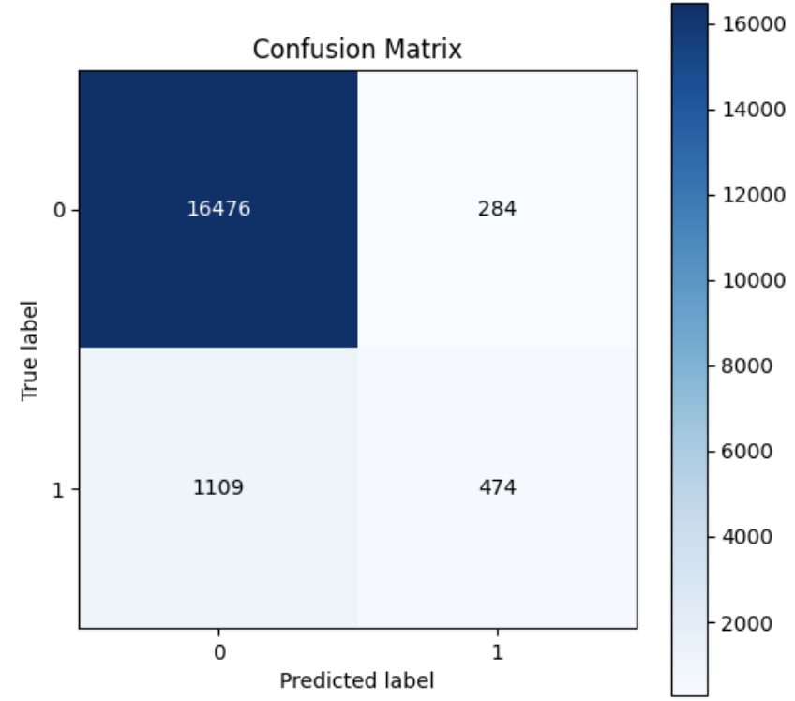
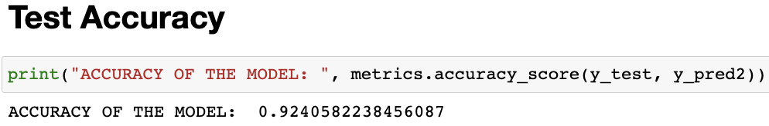
XGBOOST CLASSIFIER before SMOTE CONT.:

Slide 22

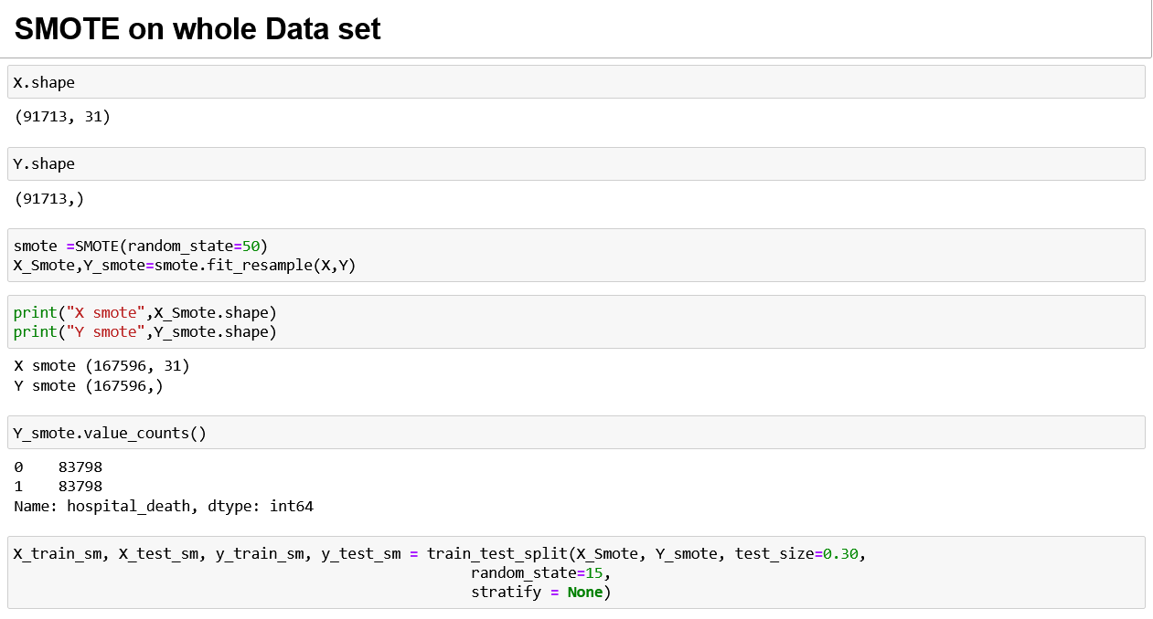
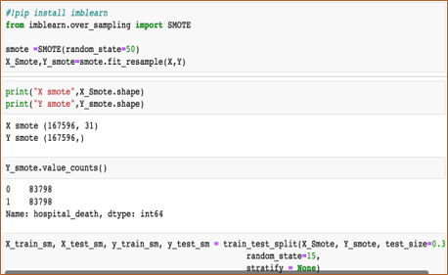
Synthetic Minority Oversampling Technique (SMOTE)

Slide 23
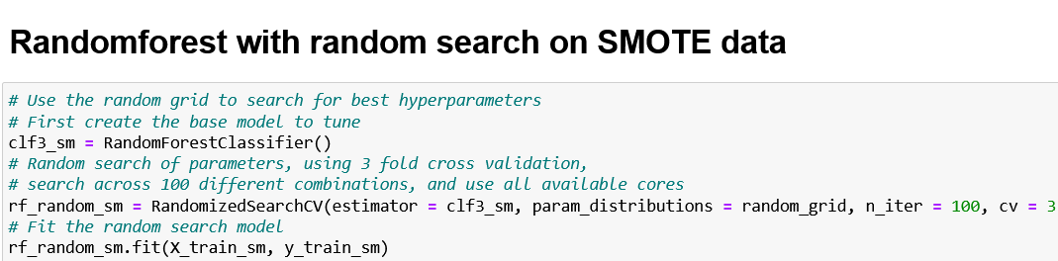

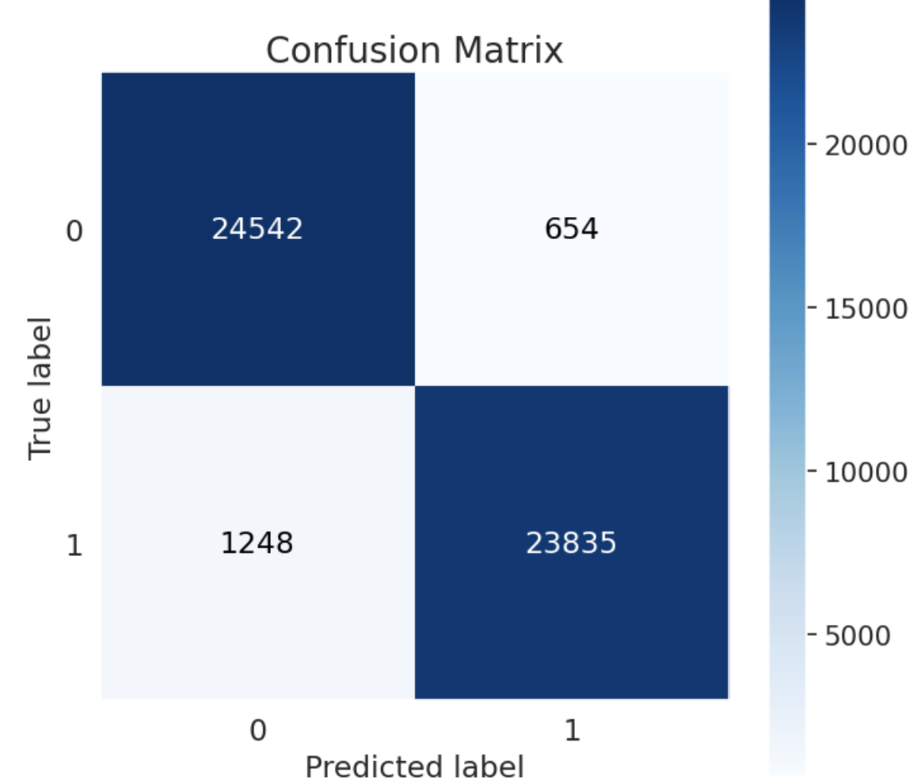
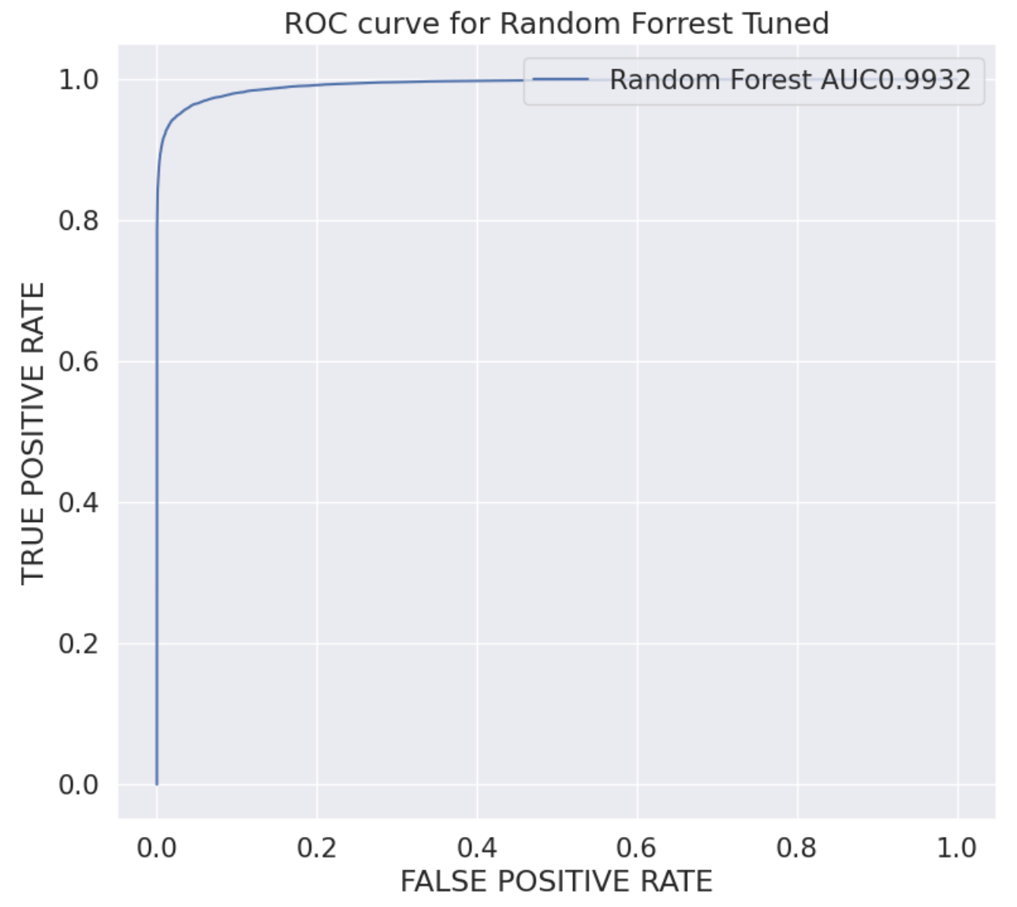
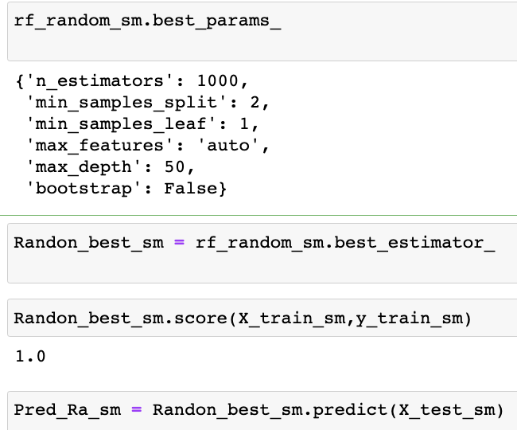
RANDOM FOREST AFTER SMOTE:​

Slide 24
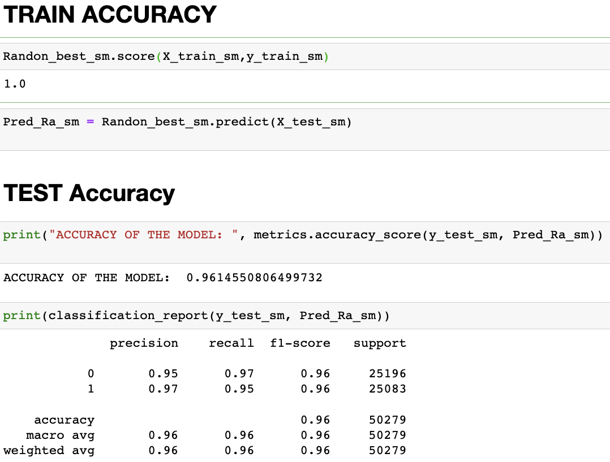
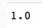
RANDOM FORREST AFTER SMOTE CONT.:

Slide 25
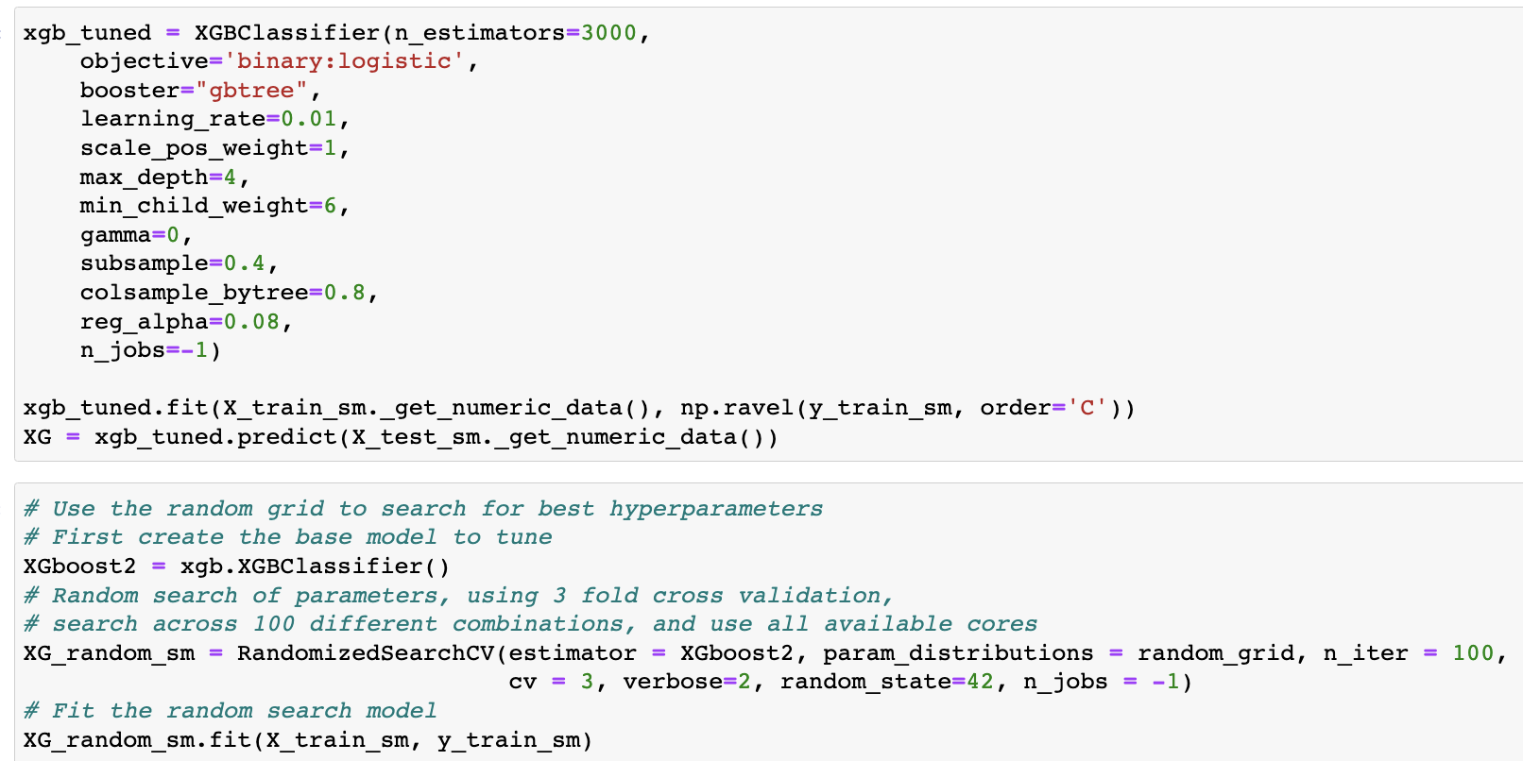
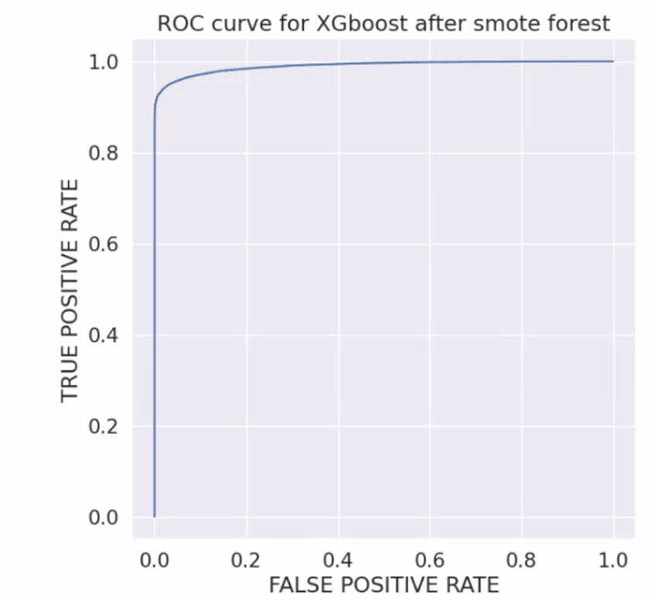

XGBOOST CLASSIFIER after SMOTE CONT.:

Slide 26



XGBOOST CLASSIFIER after SMOTE:

Slide 27
Performance Analysis Comparisons | Train Accuracy Pre-SMOTE | Test Accuracy Pre-SMOTE | F1-score Pre-SMOTE | ROC – AUC Pre-SMOTE | Train Accuracy Post SMOTE | Test Accuracy Post SMOTE | F1-score Post SMOTE | ROC – AUC Pre-SMOTE
RANDOM FORREST | 0.9999727409022762 | 0.9257482418361228 | 0.96 (0) / 0.36 (1) | 0.8720795384130612 | 1.0 | 0.9614550806499732 | 0.96 (0) / 0.96 (1) | 0.9932
XGBOOST | 0.9565898868747444 | 0.9240582238456087 | 0.96 (0) / 0.40 (1) | 0.8702458399733445 | 1.0 | 0.9601225163587184 | 0.96 (0) / 0.96 (1) | 0.99035507401978875

Slide 28


HYPOTHESIS RESULTS:
Rejecting the null hypothesis
Age, BMI, Gender, icu_admit_score, icu_type, pre_icu_los_days, apache_2_diagnosis, ventilated_apache, d1_temp_max, d1_temp_min, h1_resprate_max, h1_resprate_min, h1_spo2_max, h1_spo2_min, d1_calcium_min, d1_hco3_max, d1_platelets_max, d1_potassium_max, d1_sodium_min, d1_wbc_min, apache_4a_icu_death_prob, diabetes_mellitus, hepatic_failure, immunosuppression, solid_tumor_with_metastasis ,independently have an association with hospital_death as their p-value is significant (P < 0.05).

Slide 29
BIBLIOGRAPHY:
https://www.kaggle.com/datasets/sadiaanzum/patient-survival-prediction-dataset?select=Dataset.csv
Raffa, Jesse1; Johnson, Alistair1; Celi, Leo Anthony2,,1; Pollard, Tom1; Pilcher, David3; Badawi, Omar4. 33: THE GLOBAL OPEN SOURCE SEVERITY OF ILLNESS SCORE (GOSSIS). Critical Care Medicine: January 2019 - Volume 47 - Issue 1 - p 17 doi: 10.1097/01.ccm.0000550825.30295.dd
Conner, K. O., Meng, H., Marino, V., & Boaz, T. L. (2020). Individual and Organizational Factors Associated with Hospital Readmission Rates: Evidence from a U.S. National Sample. Journal of Applied Gerontology, 39(10), 1153–1158. https://doi.org/10.1177/0733464819870983
Heron, M. (2021). Deaths: Leading Causes for 2019. Natl Vital Stat Rep, 70(9), 1-114. https://www.ncbi.nlm.nih.gov/pubmed/34520342
Iwase, S., Nakada, T. A., Shimada, T., Oami, T., Shimazui, T., Takahashi, N., Yamabe, J., Yamao, Y., & Kawakami, E. (2022). Prediction algorithm for ICU mortality and length of stay using machine learning. Sci Rep, 12(1), 12912. https://doi.org/10.1038/s41598-022-17091-5

Slide 30


Slide 31


Slide 32
Data Dictionary
Category | Variable Name | Unit of Measure | Data Type | Description
identifier | encounter_id | None | integer | Unique identifier associated with a patient unit stay
identifier | hospital_id | None | integer | Unique identifier associated with a hospital
identifier | patient_id | None | integer | Unique identifier associated with a patient
demographic | hospital_death | None | binary | Whether the patient died during this hospitalization
demographic | age | Years | numeric | The age of the patient on unit admission
demographic | bmi | kilograms/metres^2 | string | The body mass index of the person on unit admission
demographic | elective_surgery | None | binary | Whether the patient was admitted to the hospital for an elective surgical operation
demographic | ethnicity | None | string | The common national or cultural tradition which the person belongs to
demographic | gender | None | string | The genotypical sex of the patient

Slide 33

APPENDIX:

Slide 34



IMPORTING DATA FROM PHPMyAdmin

Slide 35


DROPPING COLUMNS ACCORDING TO DOMAIN KNOWLEDGE
After dropping columns

Slide 36
Correlation Matrix

Slide 37


Slide 38


Slide 39


Slide 40


Calculating percentage of missing values in data frame
Dropping columns which have NAN value higher than 20%

Slide 41



Imputation

Slide 42





Slide 43


Imputing categorical value with mode

Slide 44


Mapping of categorical data

Slide 45

Spearman correlation

Slide 47


Dropping column after correlation

Slide 48


NaN value percentage after imputation
Model Building

Slide 49

Divided data in X & Y set's

Slide 50


Random Forest Model on original data

Slide 51


Columns which are influential for model prediction

Slide 52


Confusion Matrix

Slide 53


ROC AUC

Slide 54

Hyperparametric tuning with RandomizedSearchCV

Slide 55


Second Random forest model with RandomizedSearchCV on original data

Slide 56




Train Accuracy
Test Accuracy

Slide 57


Slide 58

XGboost Classifier original data before SMOTE

Slide 59




Slide 60


Confusion Matrix

Slide 61


Synthetic minority class oversampling on whole Data

Slide 62



Random forest with randomized search on SMOTE data
Train Accuracy

Slide 63



Slide 64

XGBoost After Smoot

Slide 65



Slide 66



Slide 67


HYPOTHESIS

Slide 68



Slide 69


VISUALIZATION

Slide 70





Slide 71




Slide 72





Slide 73





Slide 74





Slide 75





Slide 76





Slide 77
THANK YOU

